Slide 1
Optimizing Recruitment: Harnessing Machine Learning for Predictive Hiring Decisions
By
Dileep Malothu | Harika Yenuga | Mukhesh Ravi | Saketh Banda
The Richard DeVos Graduate School of Management
Northwood University
October 2024

Slide 2
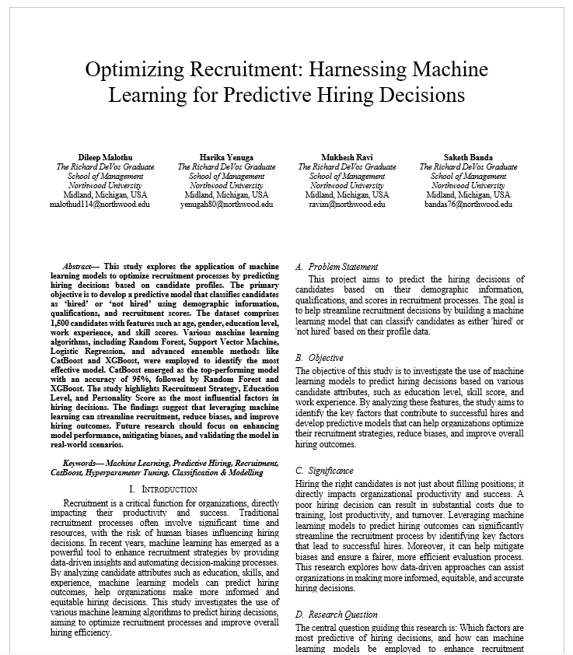
The research paper (overview)
Introduction
Methodologies
Results
Discussion
Conclusion
Future Studies

Slide 3
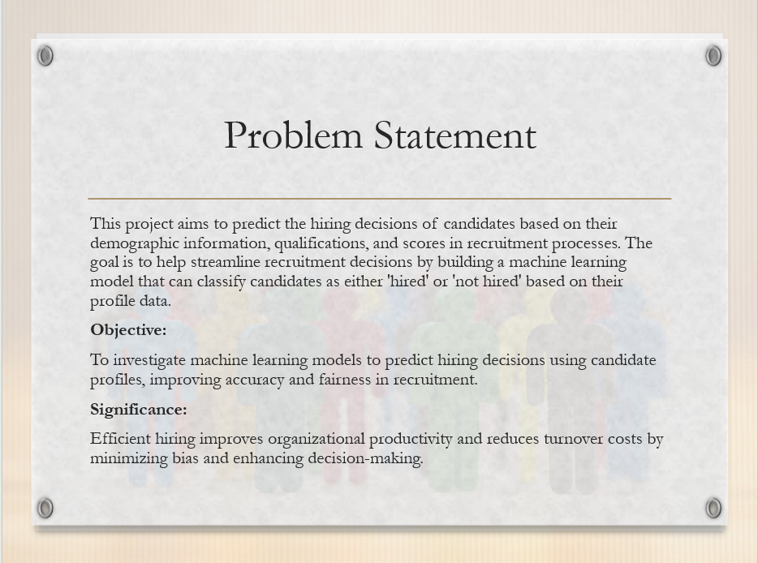

Slide 4
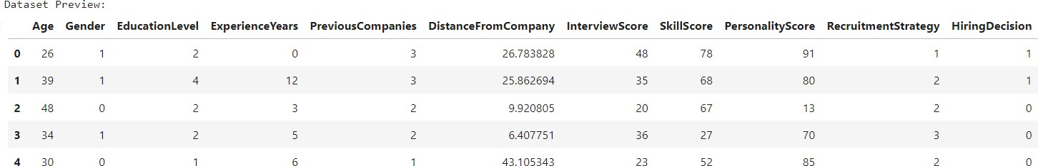
METHODOLOGIES
Dataset Title: Employment.csv
1500 Candidates
Features
Age | Gender | Education Level | Previous Companies | Distance from Company | Interview Score | Skill Score | Personality Score | Recruitment Strategy | Hiring Decision

Slide 5
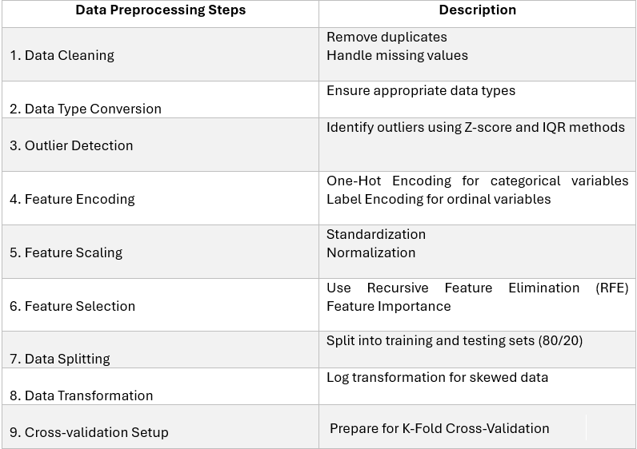
Data preprocessing

Slide 6
Models Evaluated
Random Forest: Ensemble learning with multiple trees for classification.
Support Vector Machine (SVM): Classifier that works well with high-dimensional data.
Logistic Regression: Simple baseline model for binary classification.
CatBoost: Gradient boosting designed to handle categorical features directly.
XGBoost: Efficient implementation of gradient boosting that handles large datasets.
LightGBM: Fast, scalable gradient-boosting framework.
Gradient Boosting: Boosting algorithm that builds models sequentially.
Extra Trees: Tree-based ensemble learning method.
AdaBoost: Boosting algorithm that combines multiple weak learners to create a strong classifier.

Slide 7
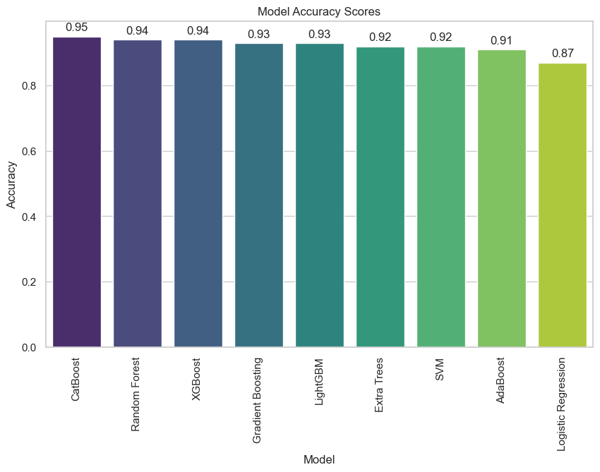
Results – Model performance

Slide 8

CatBoost Model
Random Forest Model
High precision indicates fewer incorrect hires.
High recall indicates suitable candidates aren’t missed.
Random Forest Model
XGBoost Model
XGBoost Model

Slide 9
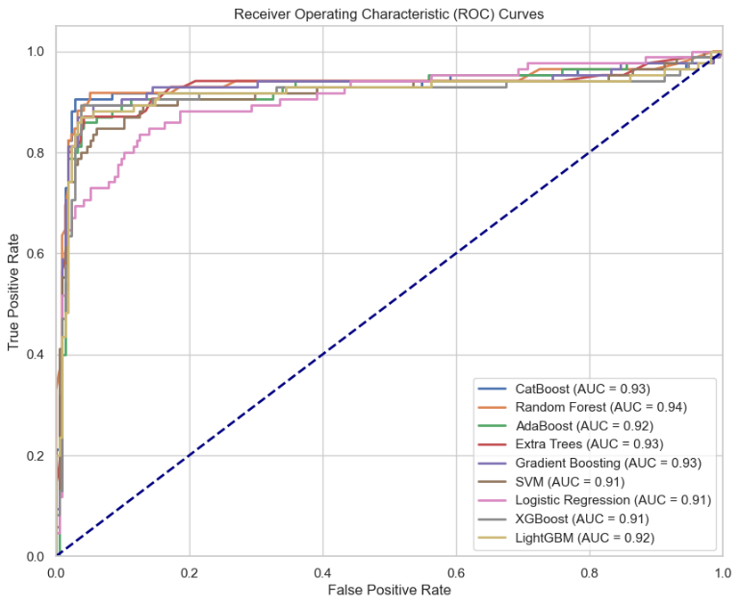
Results – ROC-AUC Curves

Slide 10
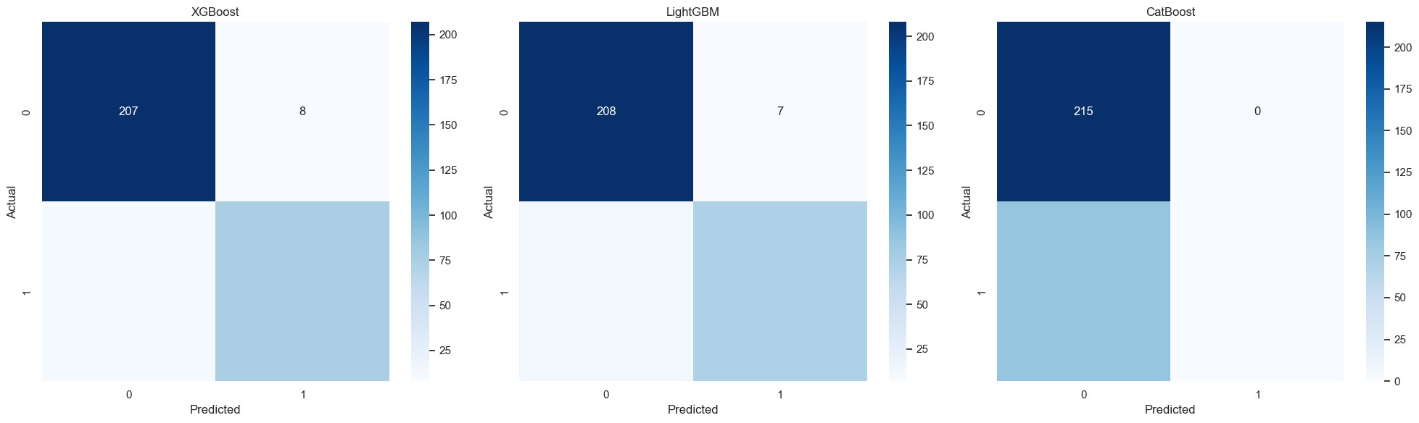
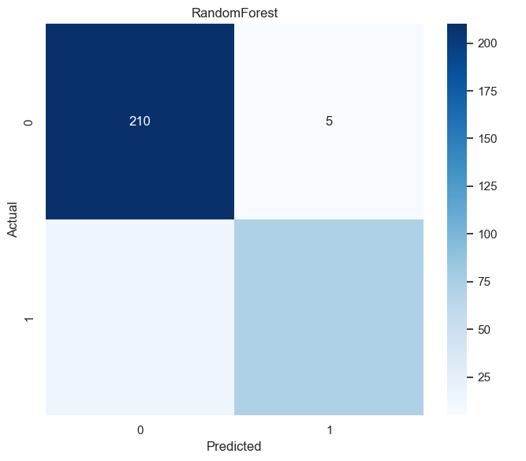
Results – Confusion Matrix
Exceptional performance
No misclassifications
Slightly higher false negatives
Some "hired" candidates were incorrectly classified as "not hired."
Higher rate of misclassification
Might be noise in the data

Slide 11
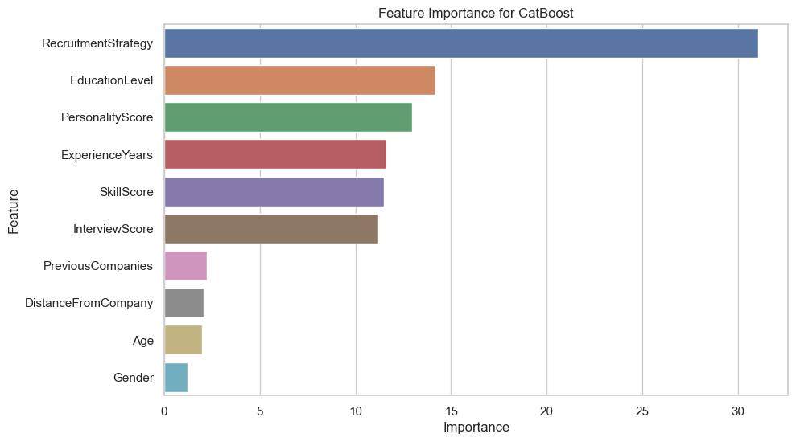
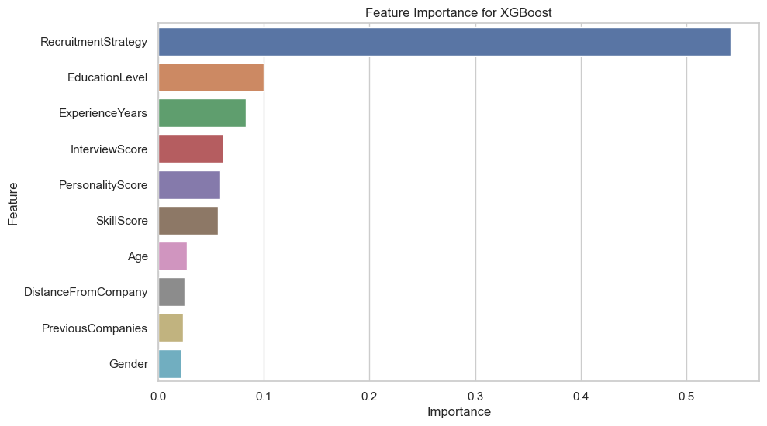
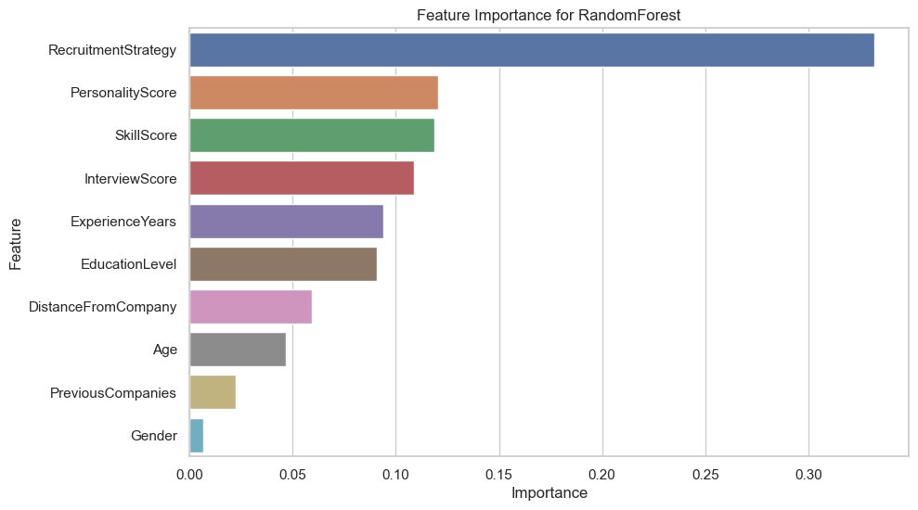
Discussion – feature importance

Slide 12
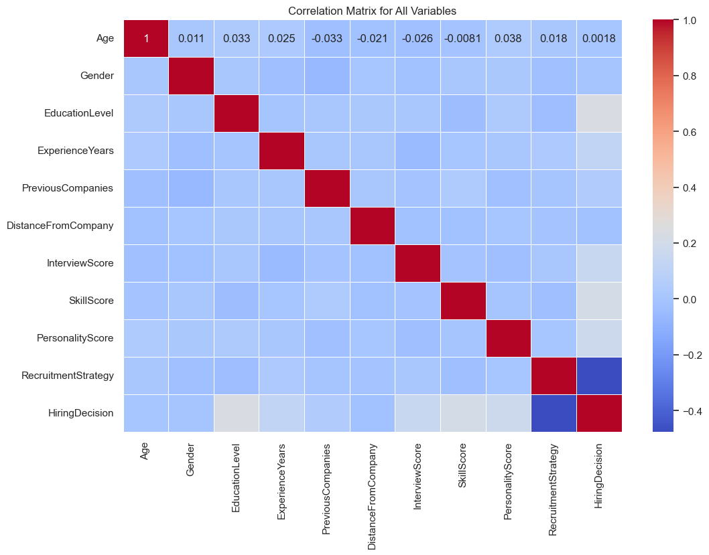
Recruitment strategy feature
While the correlation is negative, "Recruitment Strategy" plays a crucial role in the model's decision-making process due to its interaction with other factors or non-linear effects.

Slide 13
Real world implications
Streamline Recruitment
Bias Reduction
Enhanced Decision Making
Cost Savings
Scalability & Adaptability
Notes:
Streamlined Recruitment:
Implication: Organizations can use the model to automate and optimize their hiring processes, reducing the time and costs associated with recruitment. This leads to more efficient hiring practices and better allocation of HR resources.
Bias Reduction:
Implication: The model can help in making more equitable hiring decisions by minimizing human biases. This promotes diversity and inclusion within the organization, leading to a more balanced and fair workplace.
Enhanced Decision-Making:
Implication: HR professionals can leverage insights from the model to make more informed hiring decisions. By understanding the key factors that contribute to successful hires, organizations can improve their recruitment strategies and select candidates who are more likely to succeed in their roles.
Cost Savings:
Implication: By improving the accuracy of hiring decisions, organizations can reduce the costs associated with poor hires, such as training, lost productivity, and turnover. This leads to significant financial savings and improved organizational performance.
Scalability and Adaptability:
Implication: The model can be adapted to different industries and job roles, making it a versatile tool for various recruitment needs. This scalability ensures that the model remains relevant and useful across different contexts and organizational requirements.

Slide 14
conclusion
CatBoost’s Performance
Top-Performing Model
Balanced Performance
Robustness
Importance of Recruitment Strategy
Most Influential Feature
Impact on Predictions
Key Details
Notes:
CatBoost’s Performance
Top-Performing Model: CatBoost achieved the highest accuracy of 95%, outperforming other models like Random Forest and XGBoost.
Balanced Performance: Demonstrated high precision and recall scores for both ‘hired’ and ‘not hired’ classes, indicating reliable and consistent predictions.
Robustness: Showed minimal sensitivity to hyperparameter tuning, maintaining strong performance even before optimization.
Importance of Recruitment Strategy
Most Influential Feature: Recruitment Strategy emerged as the most critical factor in predicting hiring outcomes across all models.
Impact on Predictions: The strategy used in recruiting candidates significantly influenced the model’s ability to classify candidates correctly.
Key Details: Recruitment Strategy likely encompasses various aspects of the hiring process, such as recruitment channels and methodologies, which are crucial for successful hires.

Slide 15
Future works
Model Enhancement
Feature Engineering
Bias Mitigation
Real-World Validation
Scalability & Adaptability
Notes:
Model Enhancement
Explore additional machine learning algorithms and ensemble methods to further improve prediction accuracy and robustness. Investigating the integration of deep learning techniques could help handle more complex and unstructured data, potentially leading to better performance and new insights.
Feature Engineering
Develop new features that capture more nuanced aspects of candidate profiles, such as social media activity or psychometric assessments. This could provide a more comprehensive view of candidates and improve the model’s predictive power. Additionally, exploring the impact of different recruitment channels and methodologies on hiring outcomes could yield valuable insights.
Bias Mitigation
Conduct in-depth studies on the model’s potential biases and develop techniques to mitigate any identified biases. Implementing fairness-aware machine learning techniques can ensure equitable treatment of all candidates, promoting diversity and inclusion within organizations.
Real-World Validation
Test the model in real-world recruitment scenarios to validate its effectiveness and gather feedback for further refinement. Collaborating with organizations to pilot the model can help assess its impact on recruitment efficiency and diversity, providing practical insights for improvement.
Scalability and Adaptability
Investigate the scalability of the model for large-scale recruitment processes across different industries and regions. Adapting the model to cater to specific organizational needs and recruitment practices can enhance its applicability and effectiveness in various contexts.

Slide 16
Thank you

